Slide 1

Bubbl(e)
[ Working Subtitle ]

Slide 2
What is Bubbl(e)?
A friendly and interactive social media website for professional environments.

Slide 3
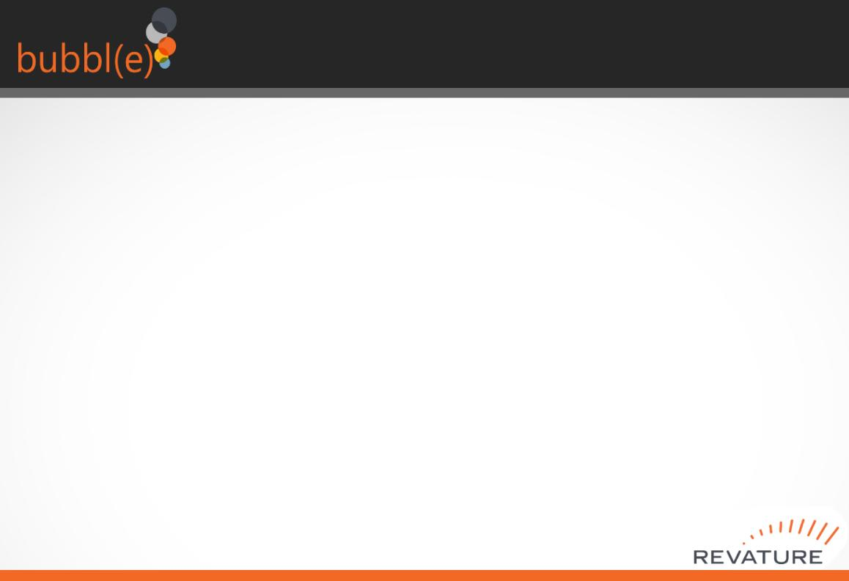
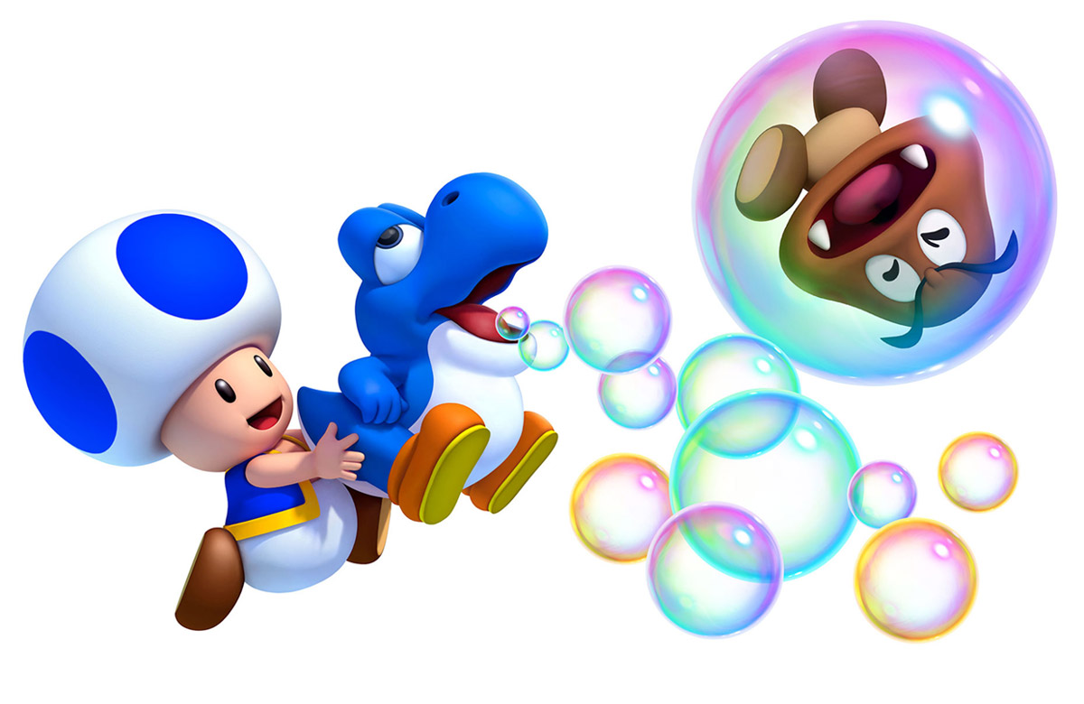
The Teams
Leader Team
Feature Team
Feature Team
Feature Team
Feature Team
Feature Team
Additional Responsibilities
Wayne Ledgister Kenny Phu
Project Coordinator Github Project Manager
Notes:
Team 1 (Somers, Michael, James, Viral, Kenny) Pagination, Search functions
Team 2 (John Blalock, Vishal, Kyle, Aaron) Session Management Security / Profanity filter Stretch – Visual presentation and refactoring CSS/bootstrap, refactored mousewheel showcase on pages
Team 3 (Zak, Tanbir, Christopher, John Boyle) Groups < Join, Create, Leave group / Group end points Group Models Stretch – Comments/Likes reformation and bug fixes
Team 4 (Wayne, Aidan, Talha, Jahred) Password Update, Email verification
Team 5 (Mark, Marouane, Christian, Jesse) Post images, Refactor Post Images Stretch – Restructing of file system in Angular, Group Visuals, Profile Page
Additional responsibilities: Kenny - Github Management, new branch allocations, Merge requests Wayne - Coordinated Team lead meetings and daily distribution of daily goals.

Slide 4
Agile-Scrum

Slide 5
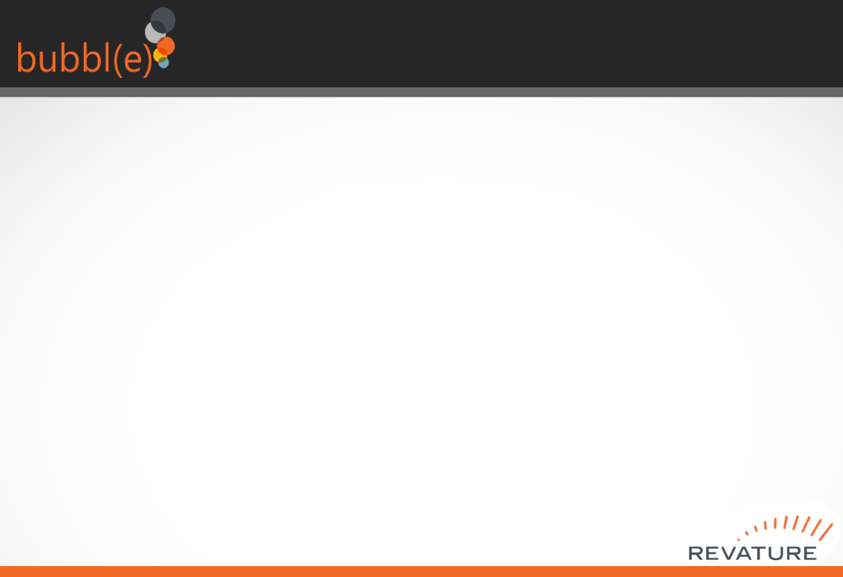
Kanban

Slide 6



Technology Stack
Notes:
Inherited Technologies
/Spring Boot
/Angular
/lombok
/OAuth2
Java Pagables
New Technologies
/Apache FreeMarker
/Spring Boot starter Mail
/Postgresql

Slide 7
Version Control
Notes:
Use Git and Github for version management
Managed over a dozen branches with changes and requests in Github.
Assisted with merge and push/pull requests.

Slide 8
Demo
Visit our page at:
[ insert working link here? ]

Slide 9
Unit Testing & SonarCloud

Slide 10
Obstacles

Slide 11
Future Features

Slide 12

Thank you!
We'll take your questions now

